Slide 1


Quality Improvement (QI) that makes a difference: getting started
Dr kinnary Martin

Slide 2
Intended Learning Outcomes
By the end of this webinar and discussion session, participants will:
Understand the potential impact of quality improvement (QI) projects in GP
Understand key models and tools for implementing QI
Analyse barriers for creating positive change in their own practice/ team and..
Generate ideas for creating an improvement culture
Start to plan one or more quality improvement projects to pilot

Slide 3
QI- What exactly is it?
“Quality improvement is about giving the people closest to issues affecting care quality the time, permission, skills and resources they need to solve them. It involves a systematic and coordinated approach to solving a problem using specific methods and tools with the aim of bringing about a measurable improvement.”
The Health Foundation, 2021
“QI helps GPs to make the most of their systems, organisations, talents and expertise to deliver better outcomes for patients.”
RCGP

Slide 4
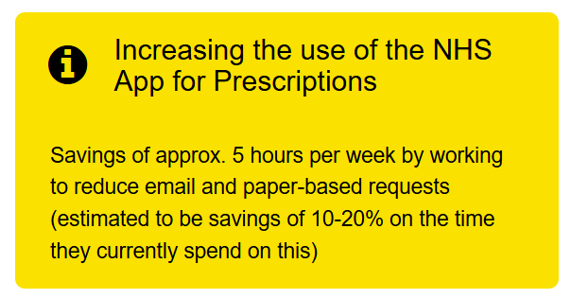
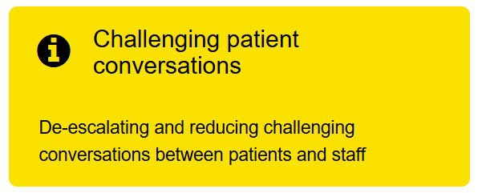
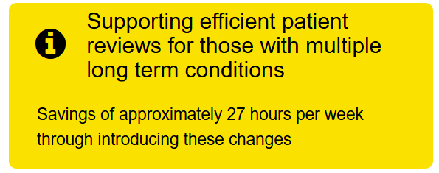
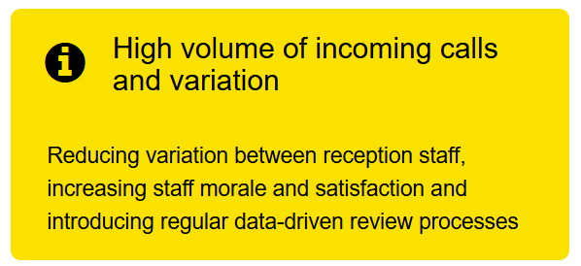
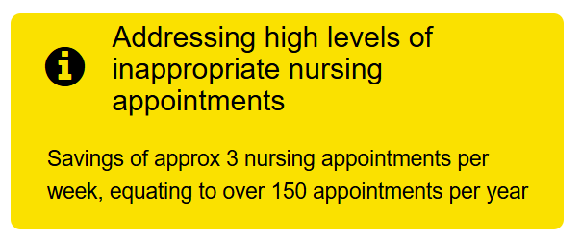
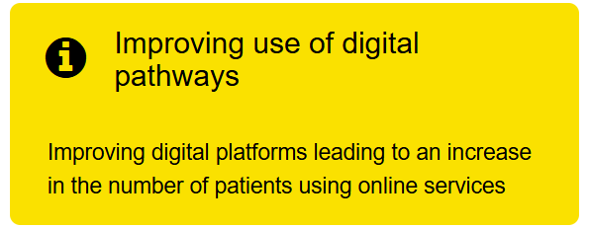
What impact can QI have on a practice? Quick wins
NHS England Primary Care Transformation Team

Slide 5

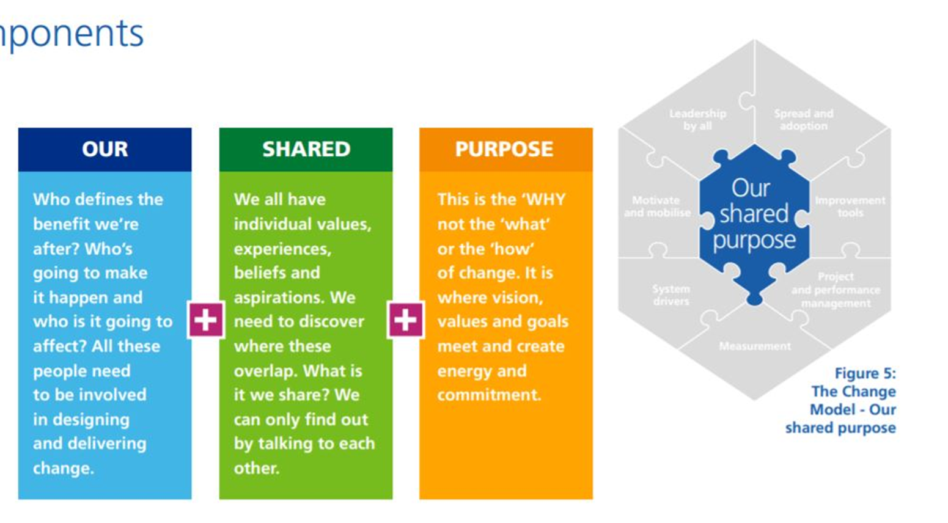
Why do we want to do this work?

Slide 6

Start with some ideas…
Areas for change e.g. Medication reviews
Website information
NHS app use
Better use of ARRS roles
Appropriate appointments
Scanning and workflow
Care home reviews
Tips: Start with a general area for change and then think about specifics
Keep it simple

Slide 7
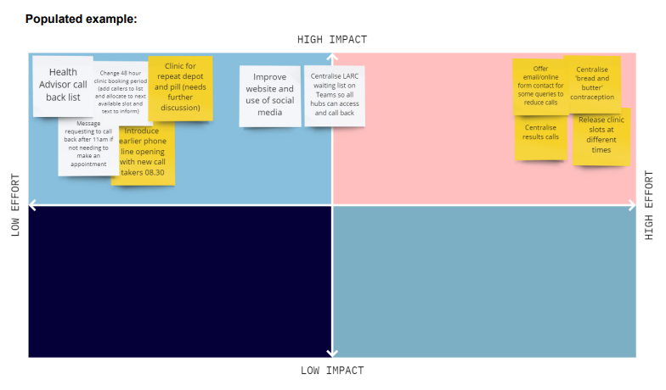
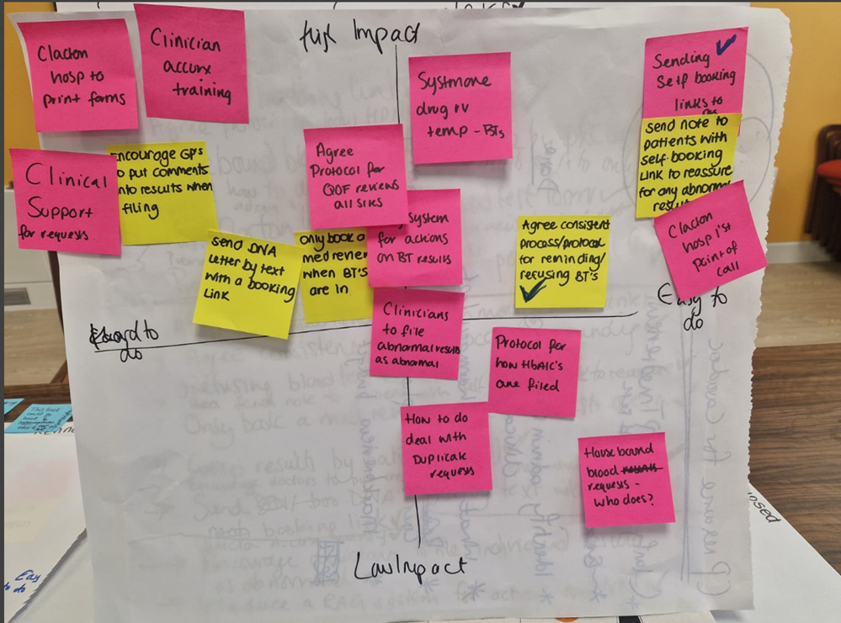
Case: Hexagon Practice
One idea (one area for change) per sticky note
Create the prioritisation matrix
Start theming ideas- similar ideas all together on the matrix

Slide 8
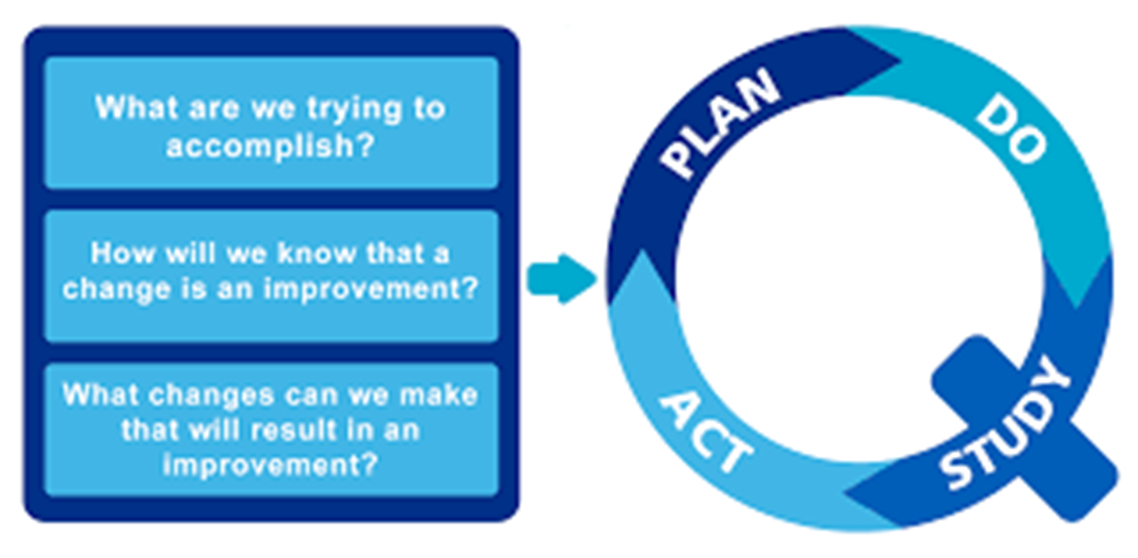
Where to begin? Model for Improvement
Institute for Healthcare Improvement

Slide 9

What are we trying to accomplish?
What is the problem? Too many blood test results- takes too much time to address, some duplication of tests so patients having blood tests un-necessarily
How do we know it is really a problem?
Measure!

Slide 10
What other measurements could the Hexagon Practice use so that they can gauge whether there is a problem?

Slide 11
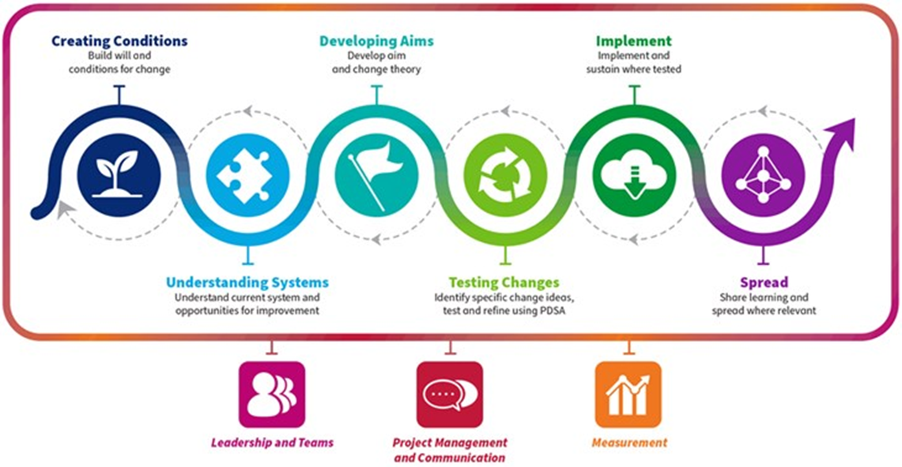
A model for the QI journey
NHS Education Scotland

Slide 12

Creating conditions for success
Plan:
Who do I need to involve?
Who are the stakeholders?
Who are my leaders? What strengths are we looking for?
What is our shared purpose?
How will we communicate with each other and with our practice teams?
How will we motivate and mobilise people?

Slide 13

Understanding systems
How does the relevant system for your problem work? Why is it not working?
Hexagon Practice
Two issues: clinicians requesting large numbers of blood tests and medicines management team not checking if blood tests had already been done recently

Slide 14
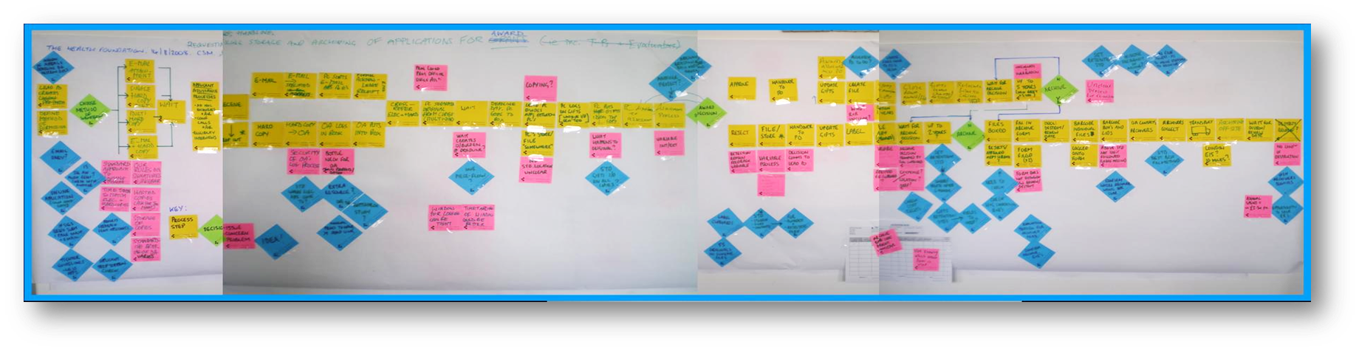
Tools for understanding systems: process mapping
A process map is a visual representation of a process, created by the people who operate and interact with the process

Slide 15
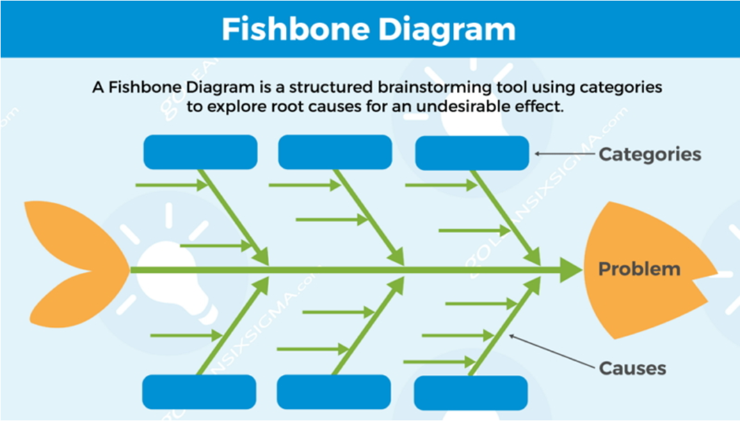
Tools for understanding systems: Fishbone diagram
Cause and effect analysis helps you to work through the possible underlying factors of a problem – not just the symptoms.

Slide 16

Developing an aim statement
SMART aim:
XXX practice will increase/ decrease YYY by ZZZ by (date)
Hexagon Practice:
We want to reduce the number of blood test results received by Hexagon Practice by 10% by 31 January 2025

Slide 17
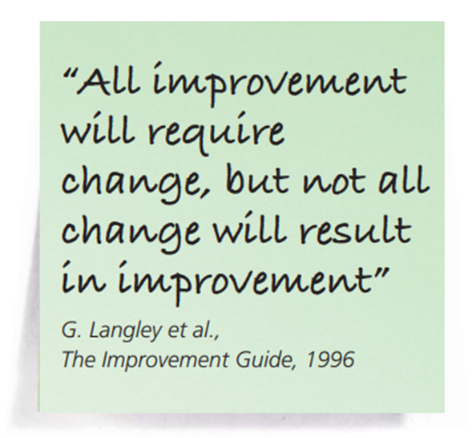
Measurement: why measure?
Understand if a change is an improvement
Demonstrate impact
Identify strengths and weaknesses
Respond
Understand progress and performance
Recognise variation
Report
Measuring the outcome of change is crucial to provide evidence that the change is happening and the desired results are being achieved.
The Change Model Guide

Slide 18

Measurement
How will we know that change is an improvement?
What do we need to measure?
Who will undertake measurement? How often (what is realistic? What is useful?)
Tip: Plot data on statistical process control (run) charts to see trend over time

Slide 19



Measures
Directly related to aim statement
Determines the end result
Assess steps in a process that lead to outcome- are you on the right track?
Measure unintended consequences

Slide 20
Ideas for Change
Collate ideas from individuals or small groups
Use a method of identifying the most popular e.g. three dots
Undertake analysis of pros and cons of most popular option
Plan HOW the change will be undertaken

Slide 21
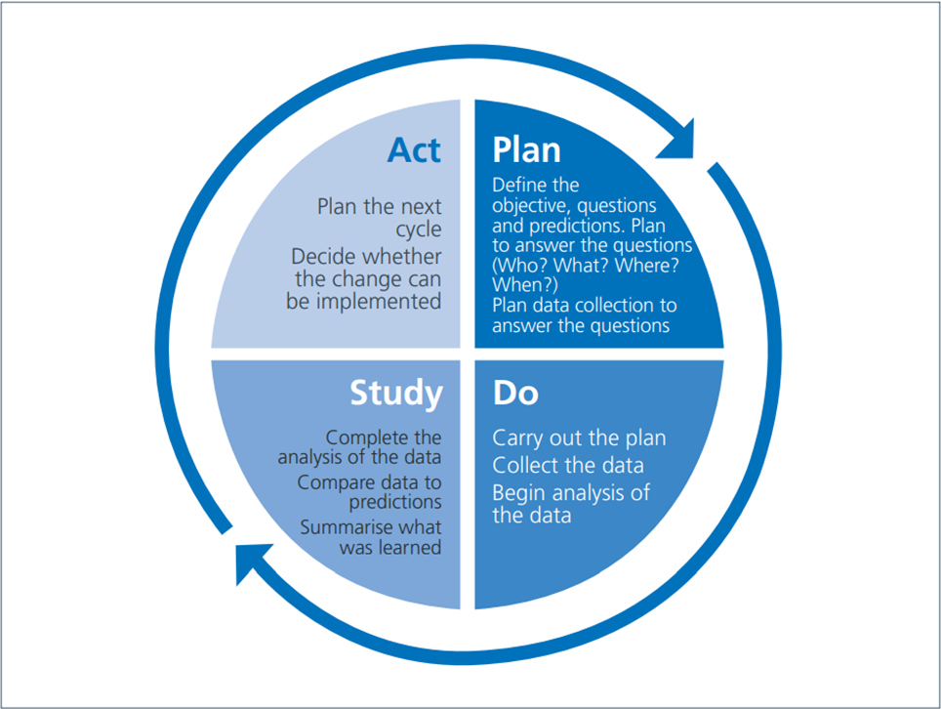
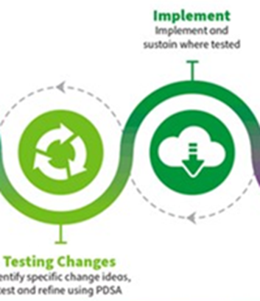
Test Changes and Implement

Slide 22
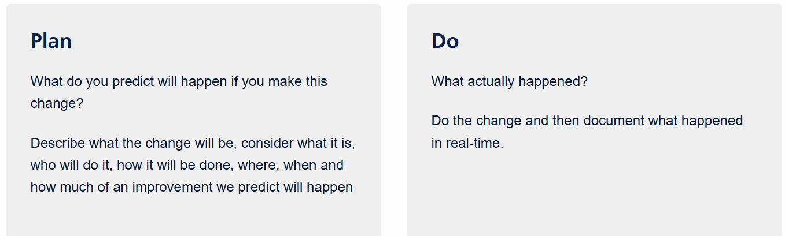
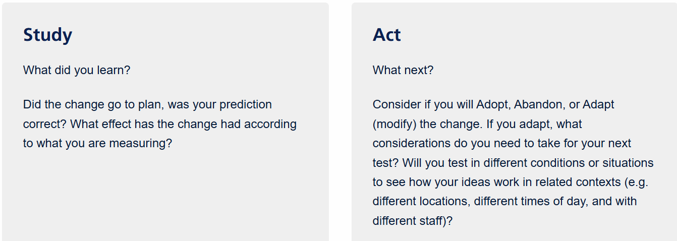
PDSA

Slide 23
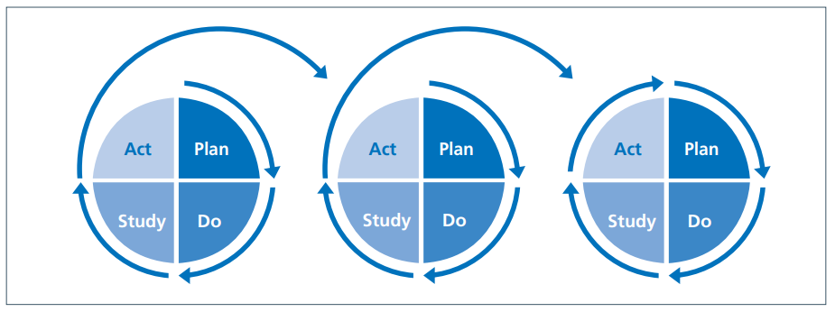
Continuous improvement
Rare to achieve success after first PDSA cycle. Often needs repeated adjustments of change idea through several PDSA cycles to achieve desired outcome

Slide 24

NHS Change Model: essential components for change

Slide 25
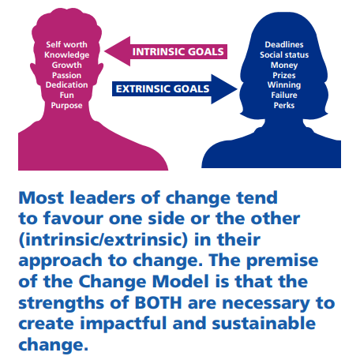
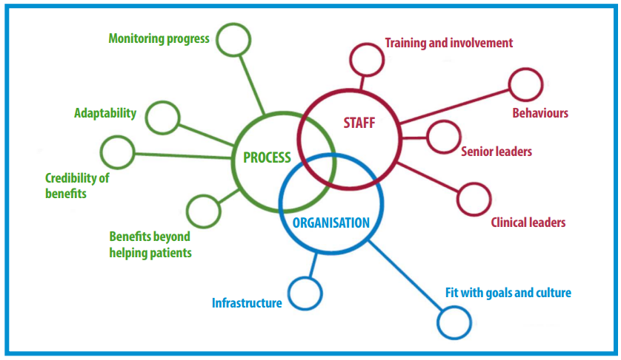
Sustainable change

Slide 26
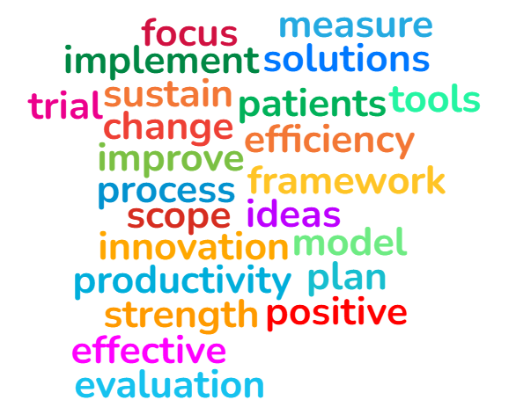
Any questions?
kinnary.martin1@nhs.net

Slide 27
Resources
First Steps towards Quality Improvement: an accessible handbook
https://www.england.nhs.uk/improvement-hub/wp-content/uploads/sites/44/2011/06/service_improvement_guide_2014.pdf
Models to guide improvement in GP
The Model for Improvement: https://qi.elft.nhs.uk/resource/the-model-for-improvement
The Change Model Guide https://www.england.nhs.uk/wp-content/uploads/2018/04/change-model-guide-v5.pdf
Measurement for improvement
Comprehensive document https://www.england.nhs.uk/improvement-hub/wp-content/uploads/sites/44/2017/11/How-to-Guide-for-Measurement-for-Improvement.pdf
Videos https://www.youtube.com/watch?v=OzvDXoBB9Ps
https://www.youtube.com/watch?v=Za1o77jAnbw

Slide 28
Resources
Tools
Prioritisation (impact effort matrix): https://www.cambscommunityservices.nhs.uk/media/cx5l4kbc/thinkqi-impact-vs-effort-matrix.pdf
Setting aims: https://www.ihi.org/library/model-for-improvement/setting-aims
Aim statement worksheet: https://www.ihi.org/library/tools/aim-statement-worksheet
Process mapping: Guide: https://aqua.nhs.uk/wp-content/uploads/2023/07/qsir-conventional-process-mapping.pdf
Video https://qi.kentcht.nhs.uk/process-mapping/
Essentials toolkit: https://www.ihi.org/library/tools/quality-improvement-essentials-toolkit

