Slide 1


Pre-Registration Trainee Pharmacy Technician Apprenticeship (PTPT)
Develop Your Pharmacy Workforce with Cambridgeshire and Peterborough Training Hub
Building sustainable pharmacy teams through funding, workforce planning and apprenticeship pathways.
Key highlights
✅ 24-month programme
✅ Level 3 Pharmacy Technician Apprenticeship
✅ GPhC Registration Route
✅Funding and Levy Transfer Support Available

Slide 2
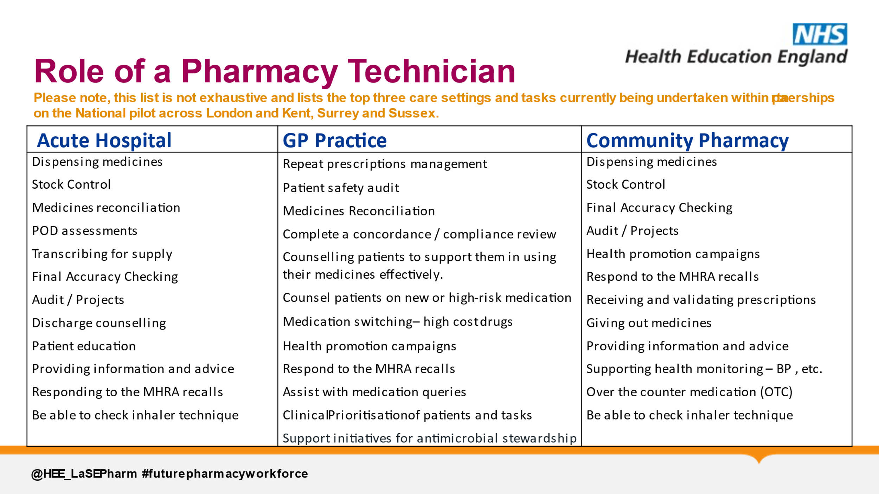
Why Pharmacy Technician Apprenticeships?
A Growing Workforce Need
Grow your own workforce, improve retention and service capacity.
Pharmacy Technicians are integral members of multidisciplinary teams, supporting:
Medicines optimisation
Structured medication reviews
Medicines safety
Long-term condition management
Patient-centred care
Benefits for Employers
✅ Grow your own workforce
✅ Improve retention
✅ Develop future pharmacy professionals
✅ Support workforce sustainability
✅ Increase service capacity

Slide 3
Programme at a Glance
24 months, Level 3 Apprenticeship, GPhC registration route.
Feature | Detail
Duration | 24 Months (based on full-time contract)
Qualification | Level 3 Apprenticeship
Registration | Eligible for GPhC Registration
Delivery | Workplace learning + Training Provider
Learner Type | Existing Staff or New Recruits
Min Age | 16+
Programme must haves:
✅ Trainee must meet eligibility criteria
✅ Supervision by a registered pharmacist or technician
✅ Rotational placement if not pharmacy onsite
✅ Must be in the role of pharmacy technician
✅ Commitment from learner and employer
English and Maths should not be a barrier, so if you do not have the required eligibility grades, there are options with most training providers or the Training Hub to complete your Level 2 Functional skills before or alongside the apprenticeship. Functional Skills - Training Hub
Pharmacy Technician (integrated) Apprenticeship Standard
Skills 4 Pharmacy Programme Information

Slide 4
Costs & Funding Made Simple
Training costs and NHSE support opportunities.
Training costs – approx. £8,000
Funding for the apprenticeship route training is available from:
  the apprenticeship levy (gifted for non-levy paying organisations) to cover 100% of the apprenticeship fees OR
  through government co-investment where you will need to pay a contribution of currently 5% of training costs
CPTH can support you in securing a levy transfer from system partners, however this cannot be guaranteed
*Non-apprenticeship route: employer responsible for all training costs*
Salary costs:
The trainee wage must be covered by the employer. If you are upskilling, you may pay the existing salary
Occasional additional funding offers may be available to support from national and regional schemes.
Newly recruited staff onto apprenticeships can be paid recommended rate as per Agenda for Change Annex 21 of Band 4 (adjusted trainee rate). This ensures standardisation across all employers.

Slide 5

Educational Support Requirements & Placements
Educational Supervisor and Practice Supervisor roles.
All placements must have a named registered professional to act as a practice/clinical supervisor.
Rotational placements need to be arranged to ensure all competencies can be met and must take place for a minimum of 12 weeks per year and can be in blocks or days
Work-based experience must be under the supervision, direction or guidance of a pharmacist/pharmacy technician to whom they are directly accountable circa 14 hours per week (including placement).
Practice/clinical supervisors will support PTPTs to identify opportunities for learning in the workplace and provide supervision of PTPTs on a day-to-day basis, identifying PTPTs requiring additional support
🎓
The Educational supervisor is a named person, responsible for the overall supervision and management of a specified trainee’s educational progress during a period of training placement or series of placements. This will include formal assessment and sign off.
The Educational supervisor is responsible for:
Liaises with education provider
Ensuring inductions are undertaken
Objective settings
Organising workplace shadowing
On the job training
Double Click to view
Formative Assessments
Progress reviews
Ensures each placement site has a Practice Supervisor in place
Ensures the Practice Supervisor understands their role
Facilitates completion of training programme

Slide 6
How C&P Training Hub Supports You
Funding, providers, workforce planning and onboarding.
Support from a dedicated project lead to provide guidance on the recruitment, enrolment and process of starting an apprentice
A repository of templates and other resources such as examples of job adverts and learning plans
Support with identifying levy transfer options and setting up a DAS account, if required
Allocation of funding and process for claiming, if available
Support identifying and connecting with training providers
If you have any further questions, please email nicola.arbon@nhs.net or visit Apprenticeships in Primary Care - Training Hub
Cambridgeshire & Peterborough Training Hub

